Slide 1

Distributed Secure Channel
Daniel Smullen
Jonathan Gillett
Joseph Heron

Slide 2
Background and Problem
Existing approaches use centralized infrastructure.
TLS (used for HTTPS)
Certificate Authorities
Other common methods use a single symmetric key for everyone.
JGroups
BitTorrent
That’s fine, but we can’t tell you from someone else.
No facility for issuing new keys, validating signatures to ensure integrity, providing authentication.

Slide 3
Nomenclature
ECC
Elliptic Curve Cryptography
ECDSA
Grain128
Initialization Vector
CSPRNG
ISAAC
SHA-256
MAC
Elliptic Curve Digital Signature Algorithm
Used to digitally sign an entity.
A new, high performance and secure stream cipher.
Stream Cipher
Generates a stream of random data used to encrypt a message.
Cryptography Term
Cryptographic Algorithm
Used to ensure a message is never encrypted the same way twice.
IV
Cryptographically Secure Pseudorandom Number Generator
A secure random number generator for cryptographic applications.
Cryptographic Algorithm
A stream cipher used to generate a highly secure random number stream. Finding a pattern is almost impossible.
Hashing Algorithm
A secure 256-bit cryptographic hashing algorithm.
Message Authentication Code
Used to validate the integrity of a message to ensure it hasn’t been altered.
A very hard computational problem that allows cryptographers to generate keys that cannot be easily solved.
MD5
Hashing Algorithm
A secure 128-bit cryptographic hashing algorithm.

Slide 4
Core Concepts I
Secure Channel
Send messages securely over an insecure network so nobody can overhear you or tamper with messages (without someone knowing).
Public Key Verification
Need to have a way of verifying someone’s public key (to make sure it’s them).
Uses challenge/response authentication.
Public Key Signing
Provide a way of guaranteeing the authenticity of a key.
Just like a signature on paper – only you can sign it.

Slide 5
Core Concepts II
Authenticated Node Announcement
Make sure every other node on the network knows when a new node’s identity has been verified.
Joining the Network (Authentication)
Requesting the encryption key from the available nodes.
Now we can view messages on the network.
Stream Cipher
What actually encrypts and decrypts the data?
Relay Chat
We need an application for the DSC network. Why not IRC?

Slide 6
Cryptographic Components
ECC
ECDSA
Stream Cipher
Initialization Vectors
Each node generates their own IV.
IVs are generated randomly using CSPRNG.
CSPRNG
Hash Functions
MAC
Each transaction signed using ECDSA.
Public Key Cryptography
SHA-256
ISAAC
Grain128
Symmetric Key Cryptography (Stream Cipher)
Signing and Verification
Public and Private Keys
MD5

Slide 7
Authentication Procedure
A user wants to join the DSC.
A group is selected to join.
Passphrase is entered.
Their client signs their key;
Their client sends out an authentication request to the cluster.
A previously authenticated client receives the request.
They can approve or deny the request;
They receive the signed public key.
If the key is valid, trust them.
Each user that trusts the client announces the new relationship.
JGroups cluster.
Or ignore them, if you don’t trust them.
It is verified using the known authentication code.

Slide 8
1:1 Key Exchange Procedure
You’ve been authenticated, but you don’t have your symmetric key yet.
Client sends a request for a key exchange.
An already authenticated client checks your authenticity.
If you’re authenticated, he’ll encrypt the symmetric key (using your public key) and send it to you.
Now you have the symmetric key, and a trust relationship is created with that member.

Slide 9
A simple Key Exchange
Starring: Alice and Bob
Featuring: Jim

Slide 17
High Level System Architecture
Message
Message Type Enumeration
Authentication Request
Authentication Acknowledge
Key Exchange
Key
Message
Message Interface
Defines the operations used for sending Message objects.
Operations
Authentication Request
Authentication Acknowledge
Key Exchange
Internal Cryptography
IRC Client
Client classes for displaying text, nicknames.
Authentication Requests
Notification Prompts
Utility
Program State Class
Globally synchronized state used to administrate system actions based on the system state.
Back Off Timer
Used to prevent synchronization issues.
Key
Message
Public Key Cryptography
Signing and Validation
Stream Cipher
Initialization Vector
CSPRNG
Hashing
MAC

Slide 18
System States
Untrusted
Requesting Authentication
Receiving Authentication Acknowledgement
Sending Key Exchange Request
Receiving Key Exchange
Trusted
Receiving Authentication Request
Authentication Decision
Receiving Authentication Acknowledgement
Sending Authentication Acknowledgement
Awaiting Key Exchange Request
Sending Key Exchange
Receiving Message
Sending Message

Slide 19
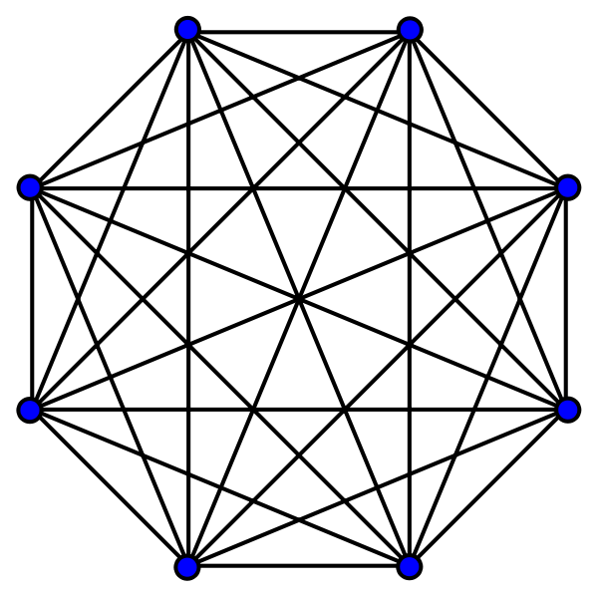
Why use this system?
Why not just use public key cryptography for everything?
How do I know the node providing me a public key is really the node it says it is?
Man in the middle attack vulnerability.
If you have n nodes, the number of key exchanges that are required must form a complete graph of exchanges.
The overhead for each client must be done n-1 times.
Huge computational overhead.

Slide 20
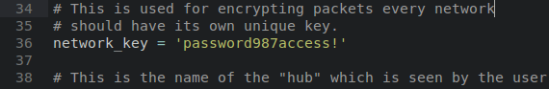
Why use this system?
Why not just hard-code a symmetric key, like JGroups?
This solution is insecure.
No way of authenticating new nodes who want to join.
Reprogramming/redistributing the key is problematic.
Cannot be deterministic.
Should be generated by CSPRNG.

Slide 21

Why use this system?
Why not just use WPA?
WPA is designed for a single or multi-point access node that is centralized.
WPA requires a fixed password.
If you need to cycle the password, it’s impossible to propagate to new nodes which use the old password.

Slide 22
Interesting Extensions/Future Work
A new cluster can be created at any time (even within a cluster), the initial nodes that create the cluster are the signing authority unless they add new signing authorities.
This cluster would have it's own unique symmetric key, and other a priori info required to join the network.

Slide 23
DEMO 1
Main Demonstration

Slide 24
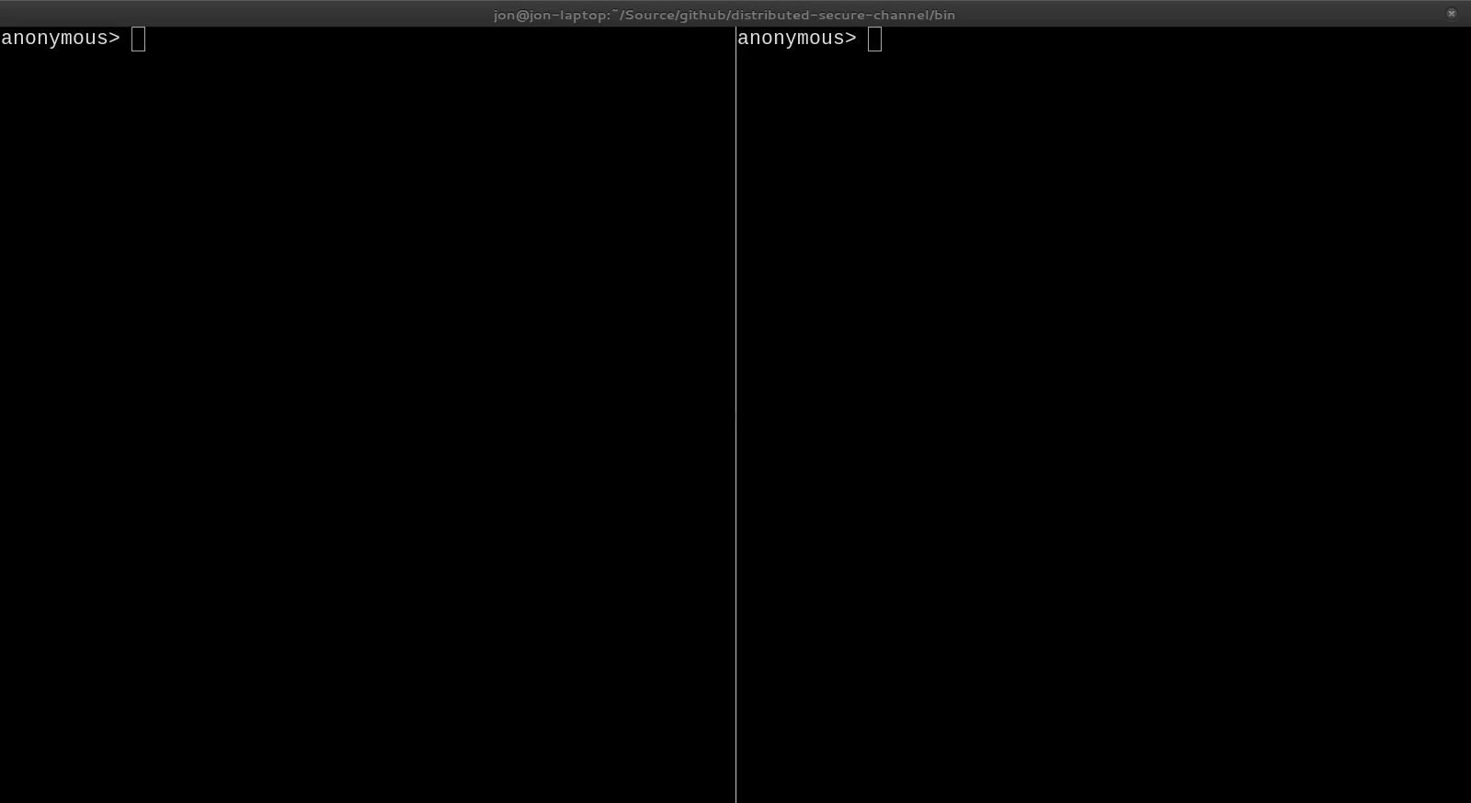

Slide 25
Demo 2
Denying an Attacker

Slide 26
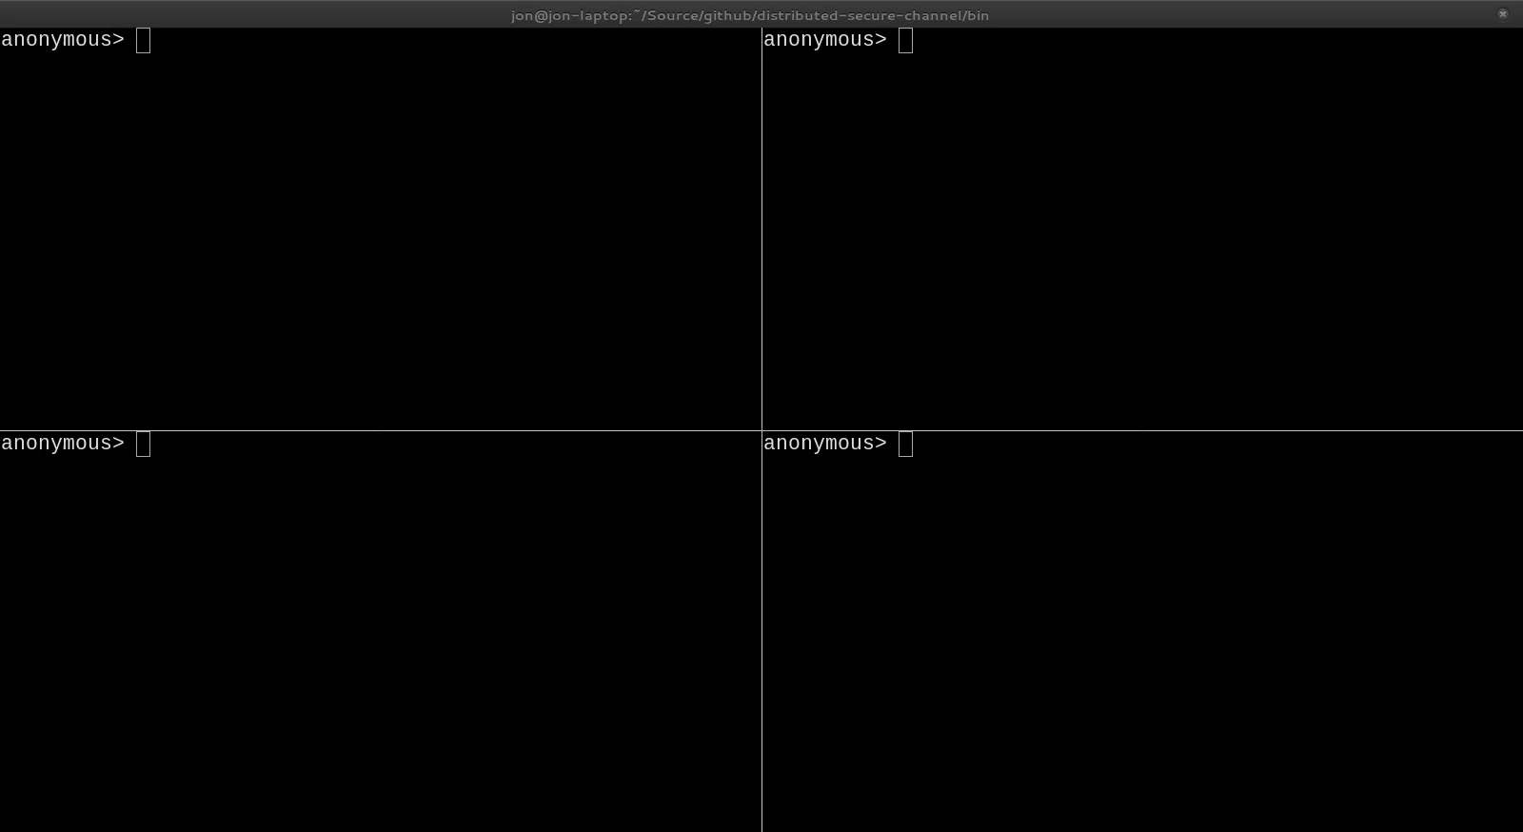

Slide 27
Demo 3
Diminishing Access

Slide 28
Diminishing Access

Slide 29
